Slide 1


Hungarian Turkey Association
November 26, 2014

Slide 2
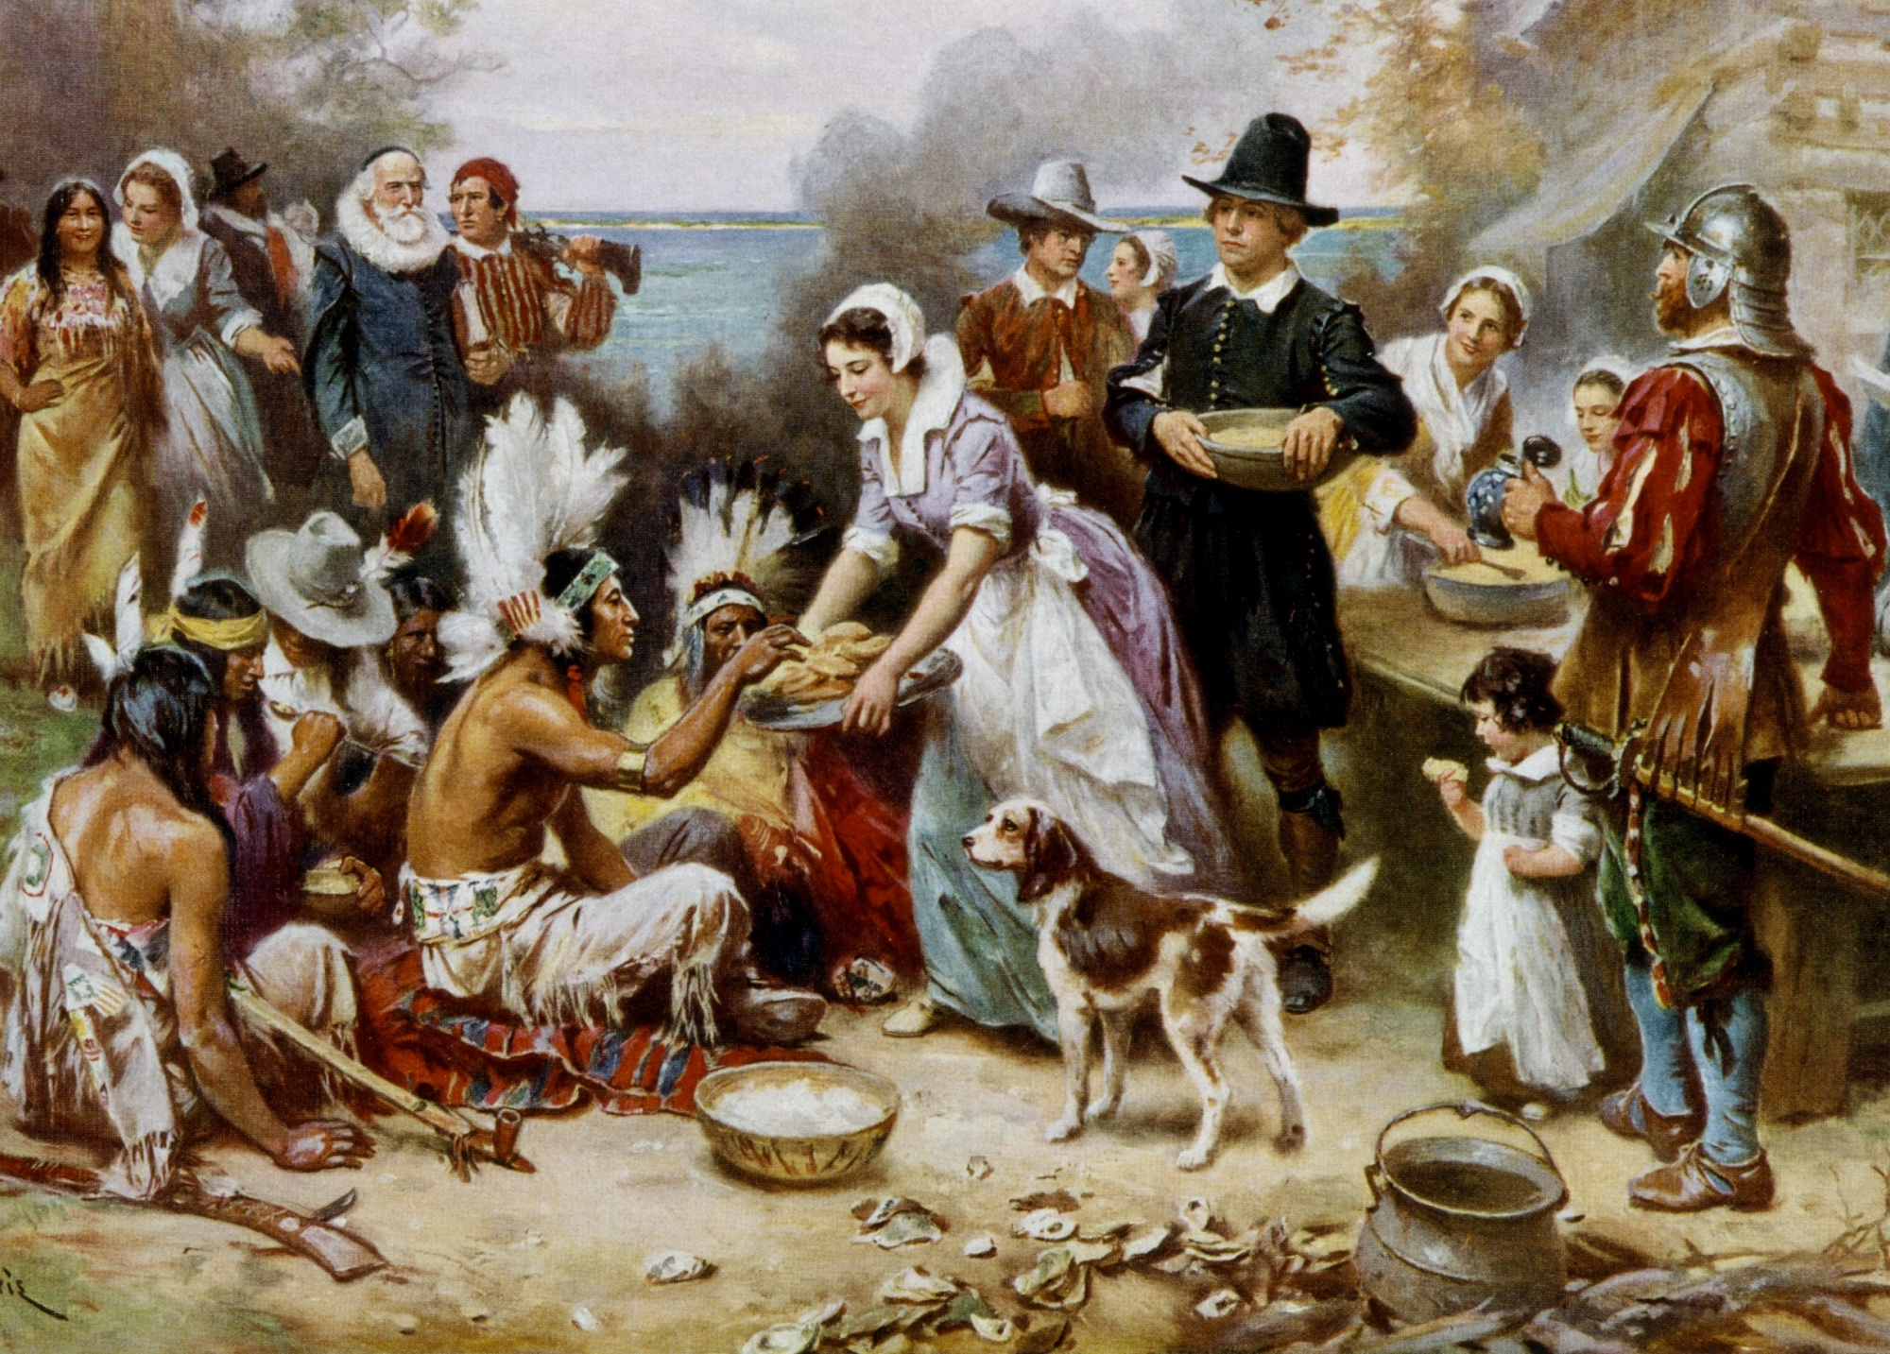
Happy Thanksgiving!
Thanksgiving 1621

Slide 3
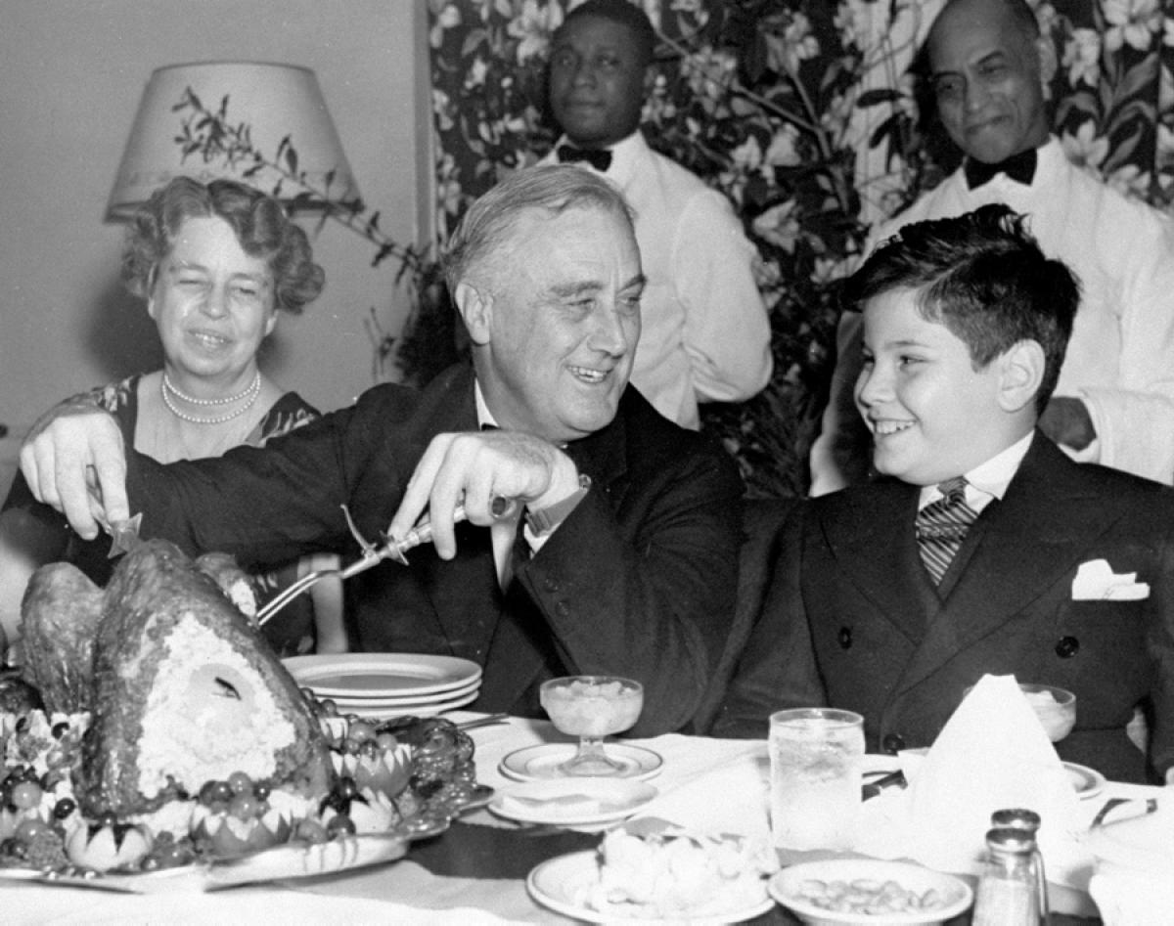
Thanksgiving is also known as
“Turkey Day”
46 million turkeys are consumed in USA, each Thanksgiving.
88 percent of Americans eat turkey at Thanksgiving.
= 334,000,000 kg / year
President Franklin D. Roosevelt

Slide 4
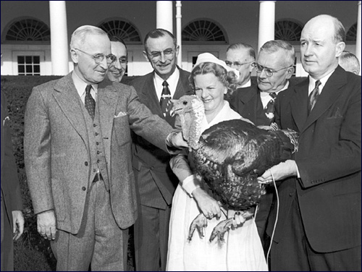

The National Turkey Federation presents a Turkey to the President Each year
President Harry Truman
1949

Slide 5

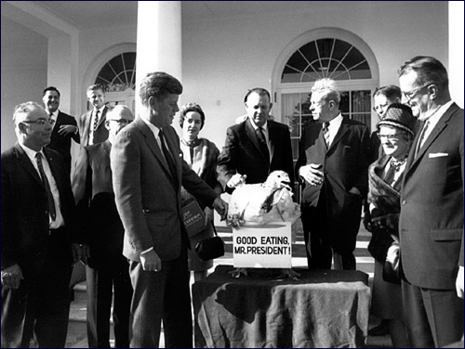
President John F. Kennedy
1963

Slide 6
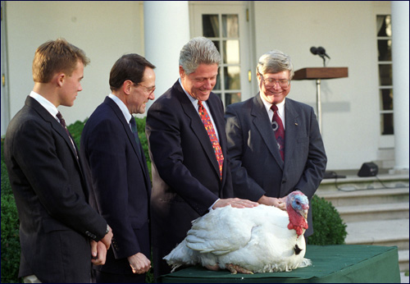
President William (Bill) Clinton

Slide 7
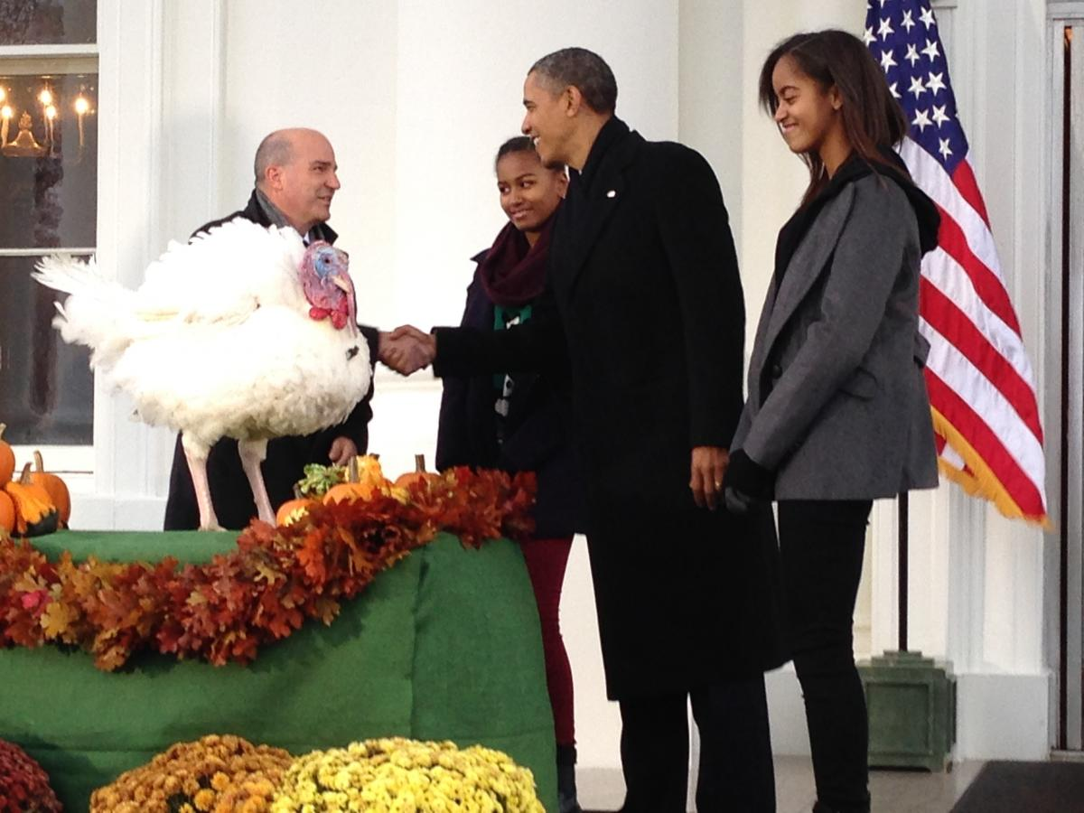
President Barack Obama

Slide 8
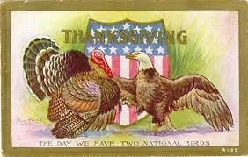

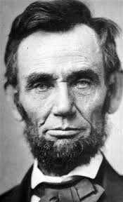

“a day of Thanksgiving and Praise”
    President Abraham Lincoln
    1863

Slide 9

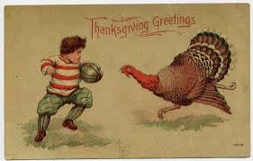
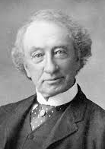
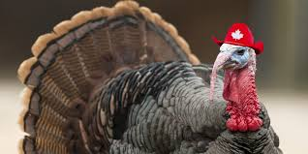
Celebrated in Canada
1879
Prime Minister
Sir John A Macdonald

Slide 10
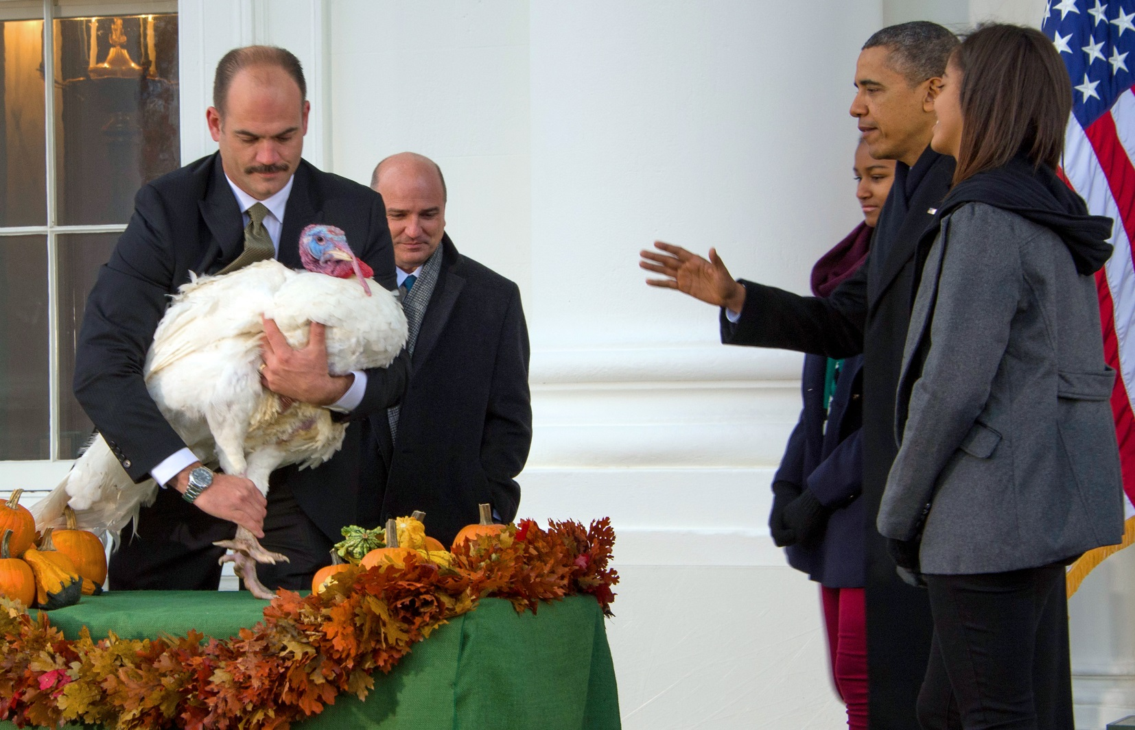
The “Presidential Turkey”
The Breed: Hybrid Converter, each year since 2008
Including 2014
Peter Gruhl, Hybrid’s Director of Customer Service

Slide 11
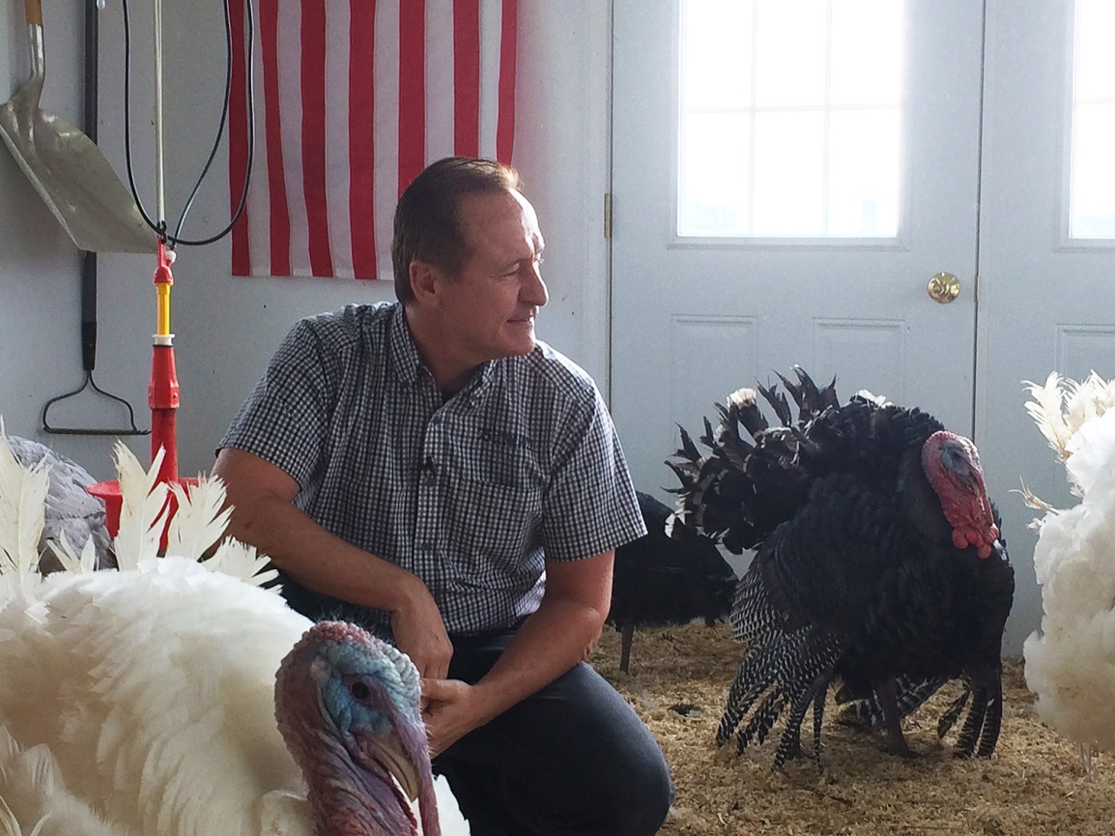
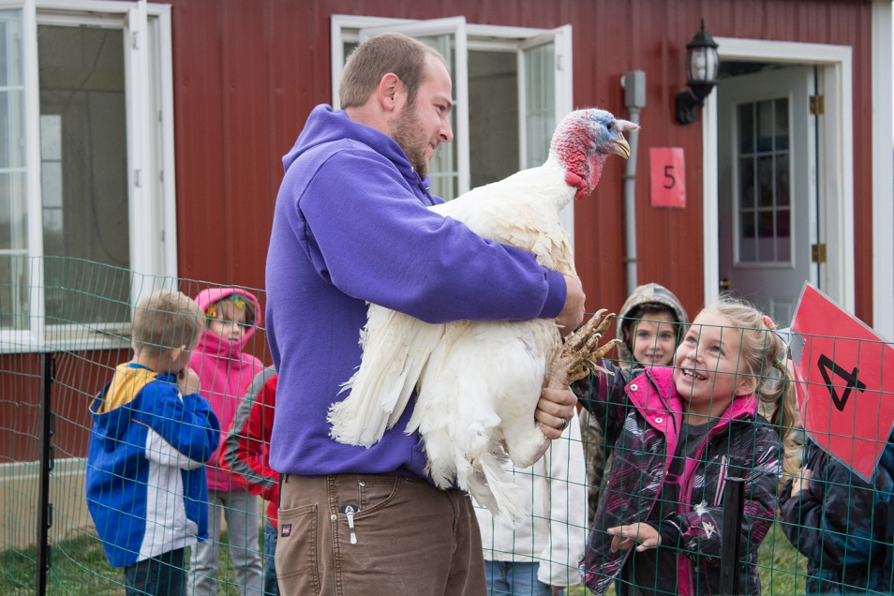
Personal Greetings From Gary Cooper,
Chairman, National Turkey Federation, USA
“Happy Thanksgiving wishes to the Hungarian Turkey Association. And, best wishes for success.” Gary Cooper
3,000 children toured to see the Presidential Turkey flock

Slide 12


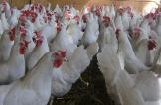
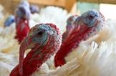
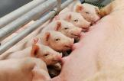
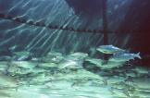
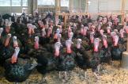





Hendrix Genetics family
Shared R & D
Shared Services
HGIS
Layer
Breeding
Turkey
Breeding
Pig
Breeding
Aquaculture
Breeding
Traditional Poultry
Breeding

Slide 13
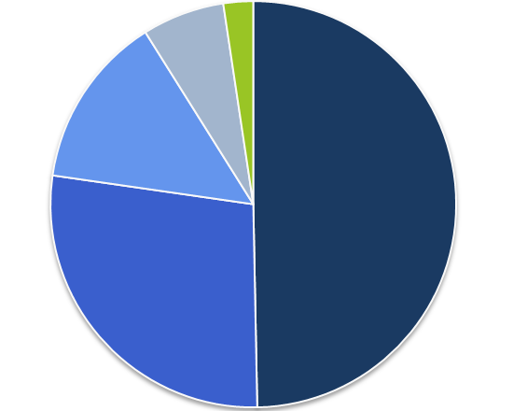
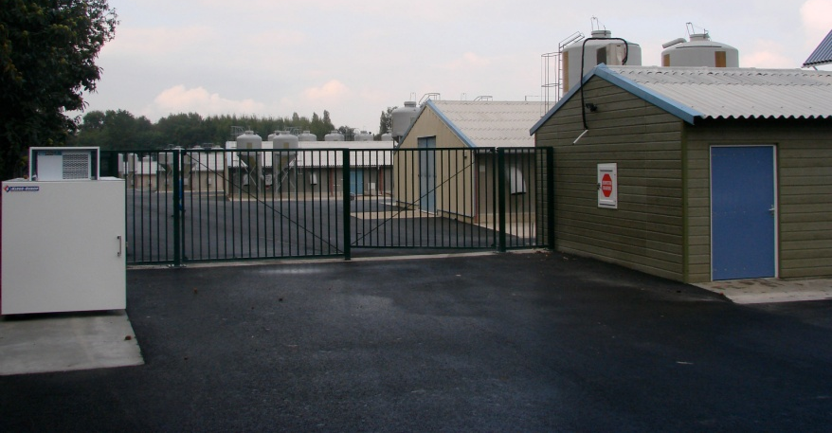
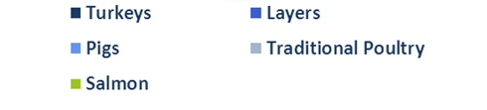
Hendrix Genetics – Turkey is our #1 business

Slide 14



The Market Place – % Share of World Market
Hybrid
ISA
LNS
Hypor

Slide 15

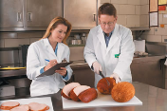
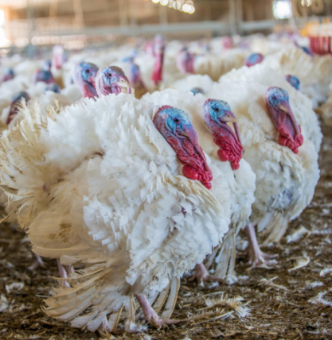

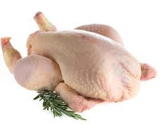
Hendrix Genetics Turkey Division
Solutions across the Turkey Production Chain
Breeding
Commercial Production
Processing
Multiplication

Slide 16
Genetic Progress in Turkeys
98 days for 11 kg turkey
FCR 2,13:1
KG Feed / KG Turkey
today
196 days for 11 kg turkey
FCR 4,2:1
KG Feed / KG Turkey
1960
Source: Dr. K. Krueger, 2010

Slide 17
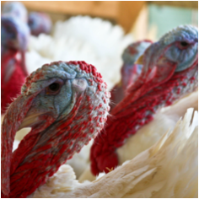
Annual Improvements Today
 | Hybrid Converter
 | Projections 2014 versus 2013
Body Weight Females at 14 weeks (grams) | + 170
Body Weight Males at 21 weeks (grams) | + 490
Walking Ability (points) (Hybrid Leg Score) | + 0.055
Feed Conversion Ratio (kg/kg) | - 0.037
Breast Meat Yield (%) | + 0.15
Egg Production (# eggs) | + 0.71

Slide 18

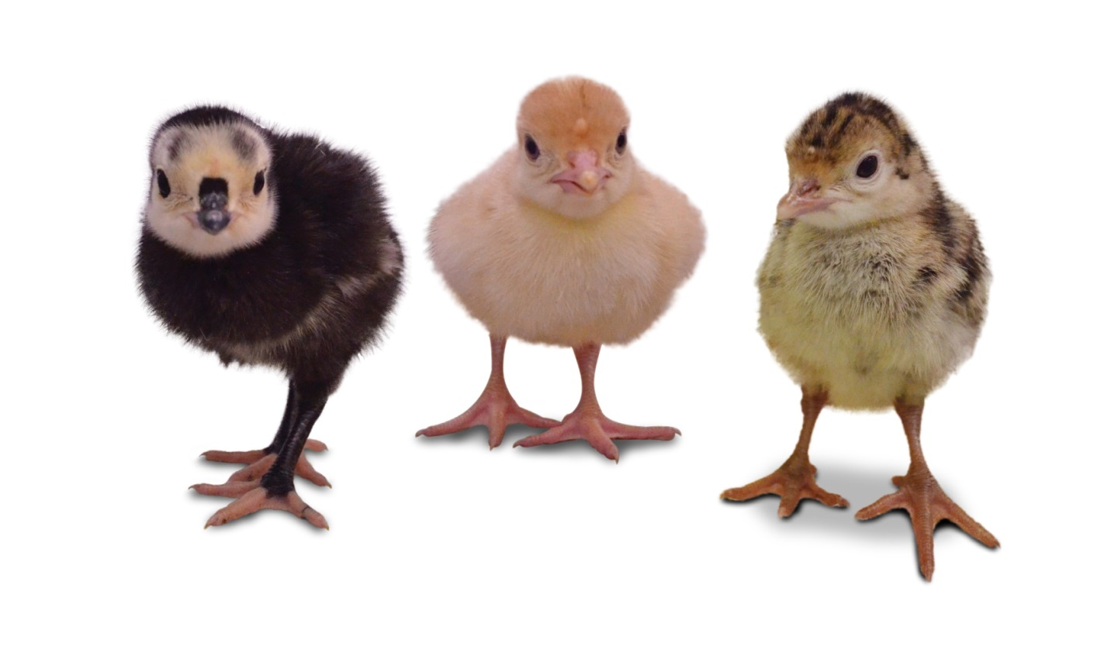
New Types of Turkeys for the Market
Bronze Broad Breasted
Black Yellow Skin
Black White Skin
“Mini Classic”
Red Feathered
(Guinea Fowl too)

Slide 19





World Class Operations: HG Turkey Division
Canada
Head Office
Pedigree Complexes
Great Grand Parents
Grand Parents
Hatcheries
Laboratory
France
Grand-Parent Farms
Hatcheries
Research Farms
Parent Stock
Laboratories
Poland
Parent Stock Farms &
Hatchery
Hybrid USA
New...
GP Farms
Hatchery
&
Parent Stock Production
Hungary
Parent Stock Farms
Notes:
Iets anders op verzinnen

Slide 20
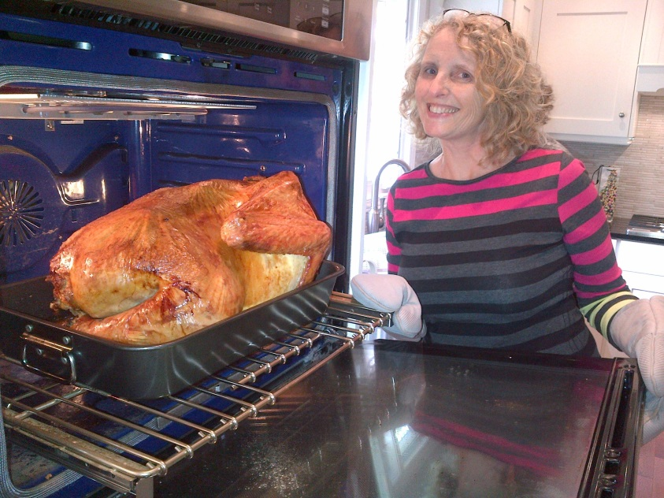
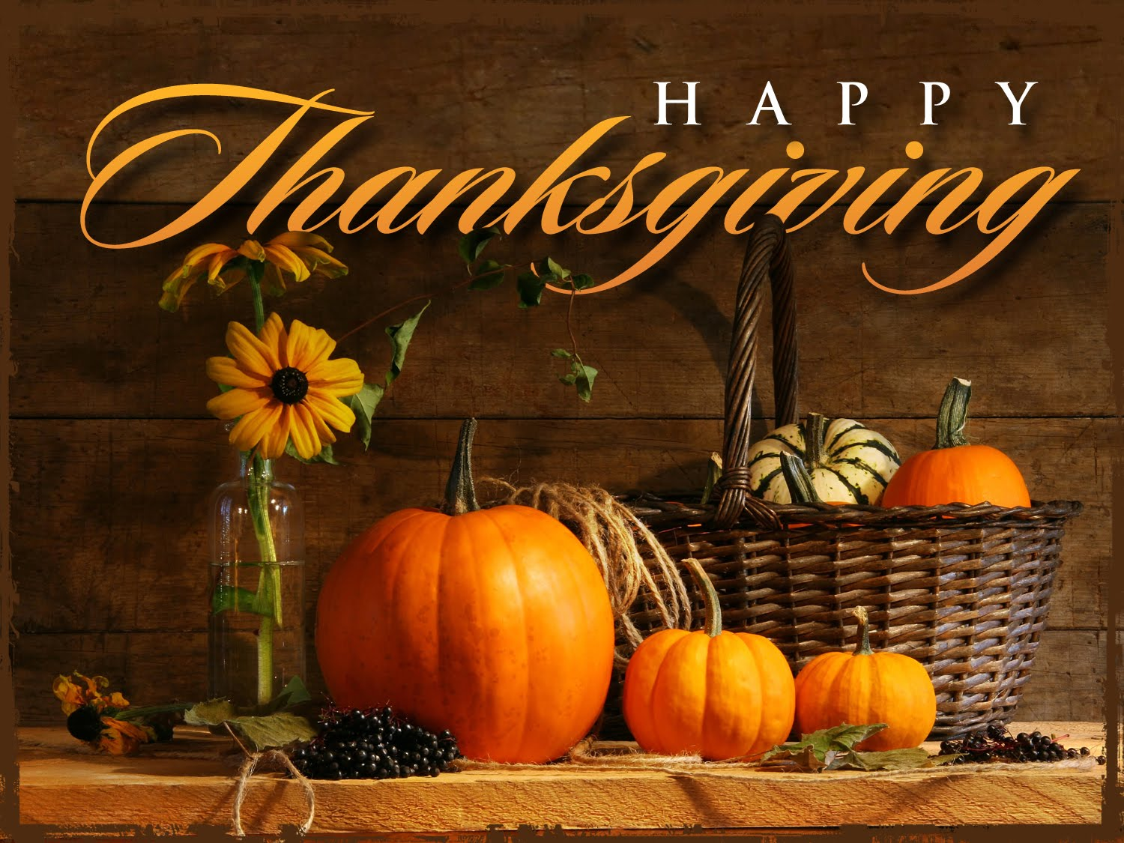

Thank You and …
Happy Thanksgiving!

